Slide 1
DRaTS
Christoph von Braun

Slide 2
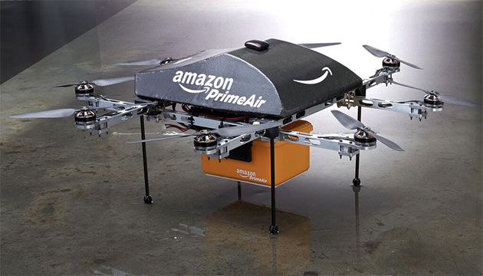
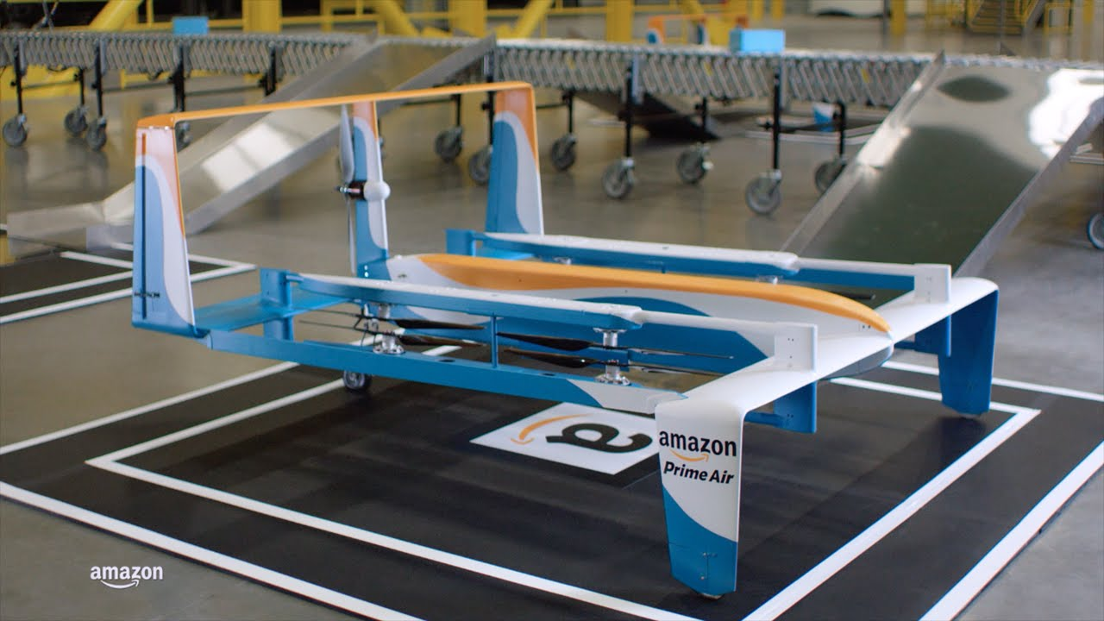
Amazon Prime Air
Notes:
Let me remind you about Amazon Prime Air. Back in 2013, the world was given a brief introduction of the photo on the left. Amazon’s new drone delivery system. Last December, we got a look at an updated design and a new prototype. The premise remained the same; 30 minute delivery of thousands of small items on amazon via autonomous drones. This is the first widespread system that we’ve seen using autonomous drones as of yet. As this is still many years off, we have some time to tackle the obvious issues that will accompany such a system.

Slide 3

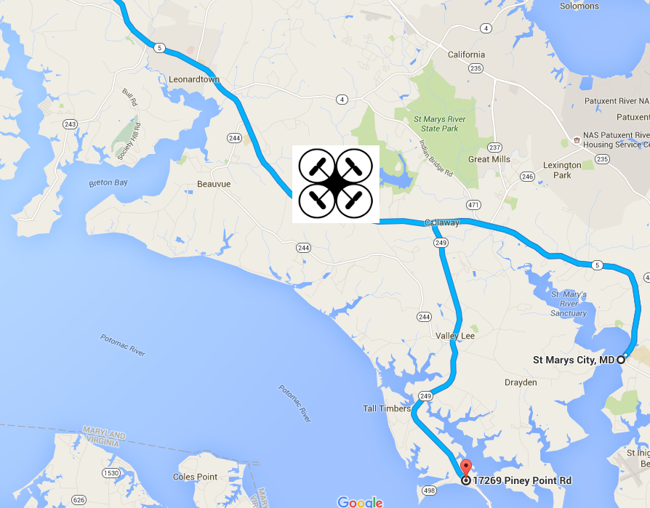
Intrusion
Bugged code
Notes:
Break this into two slides. One image for each category of something going wrong. Maybe a map with a red and blue line for correct and incorrect way to go.

Slide 4
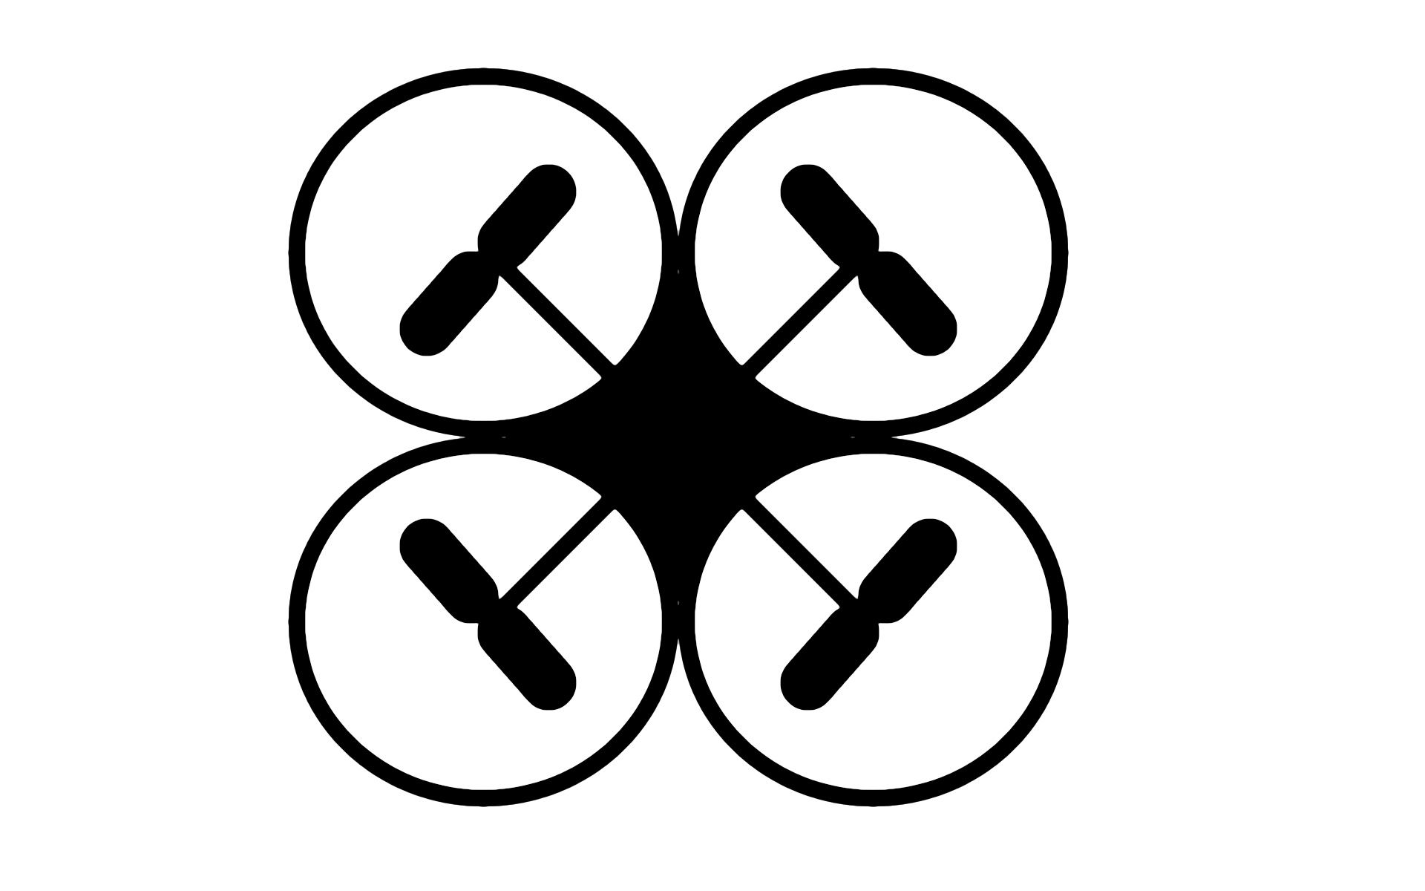
Drone
Recognition
and
Tracking
Suite
Notes:
After this add a slide about the whole project. How would Amazon actually use this technology? Why wouldn't GPS work?

Slide 5
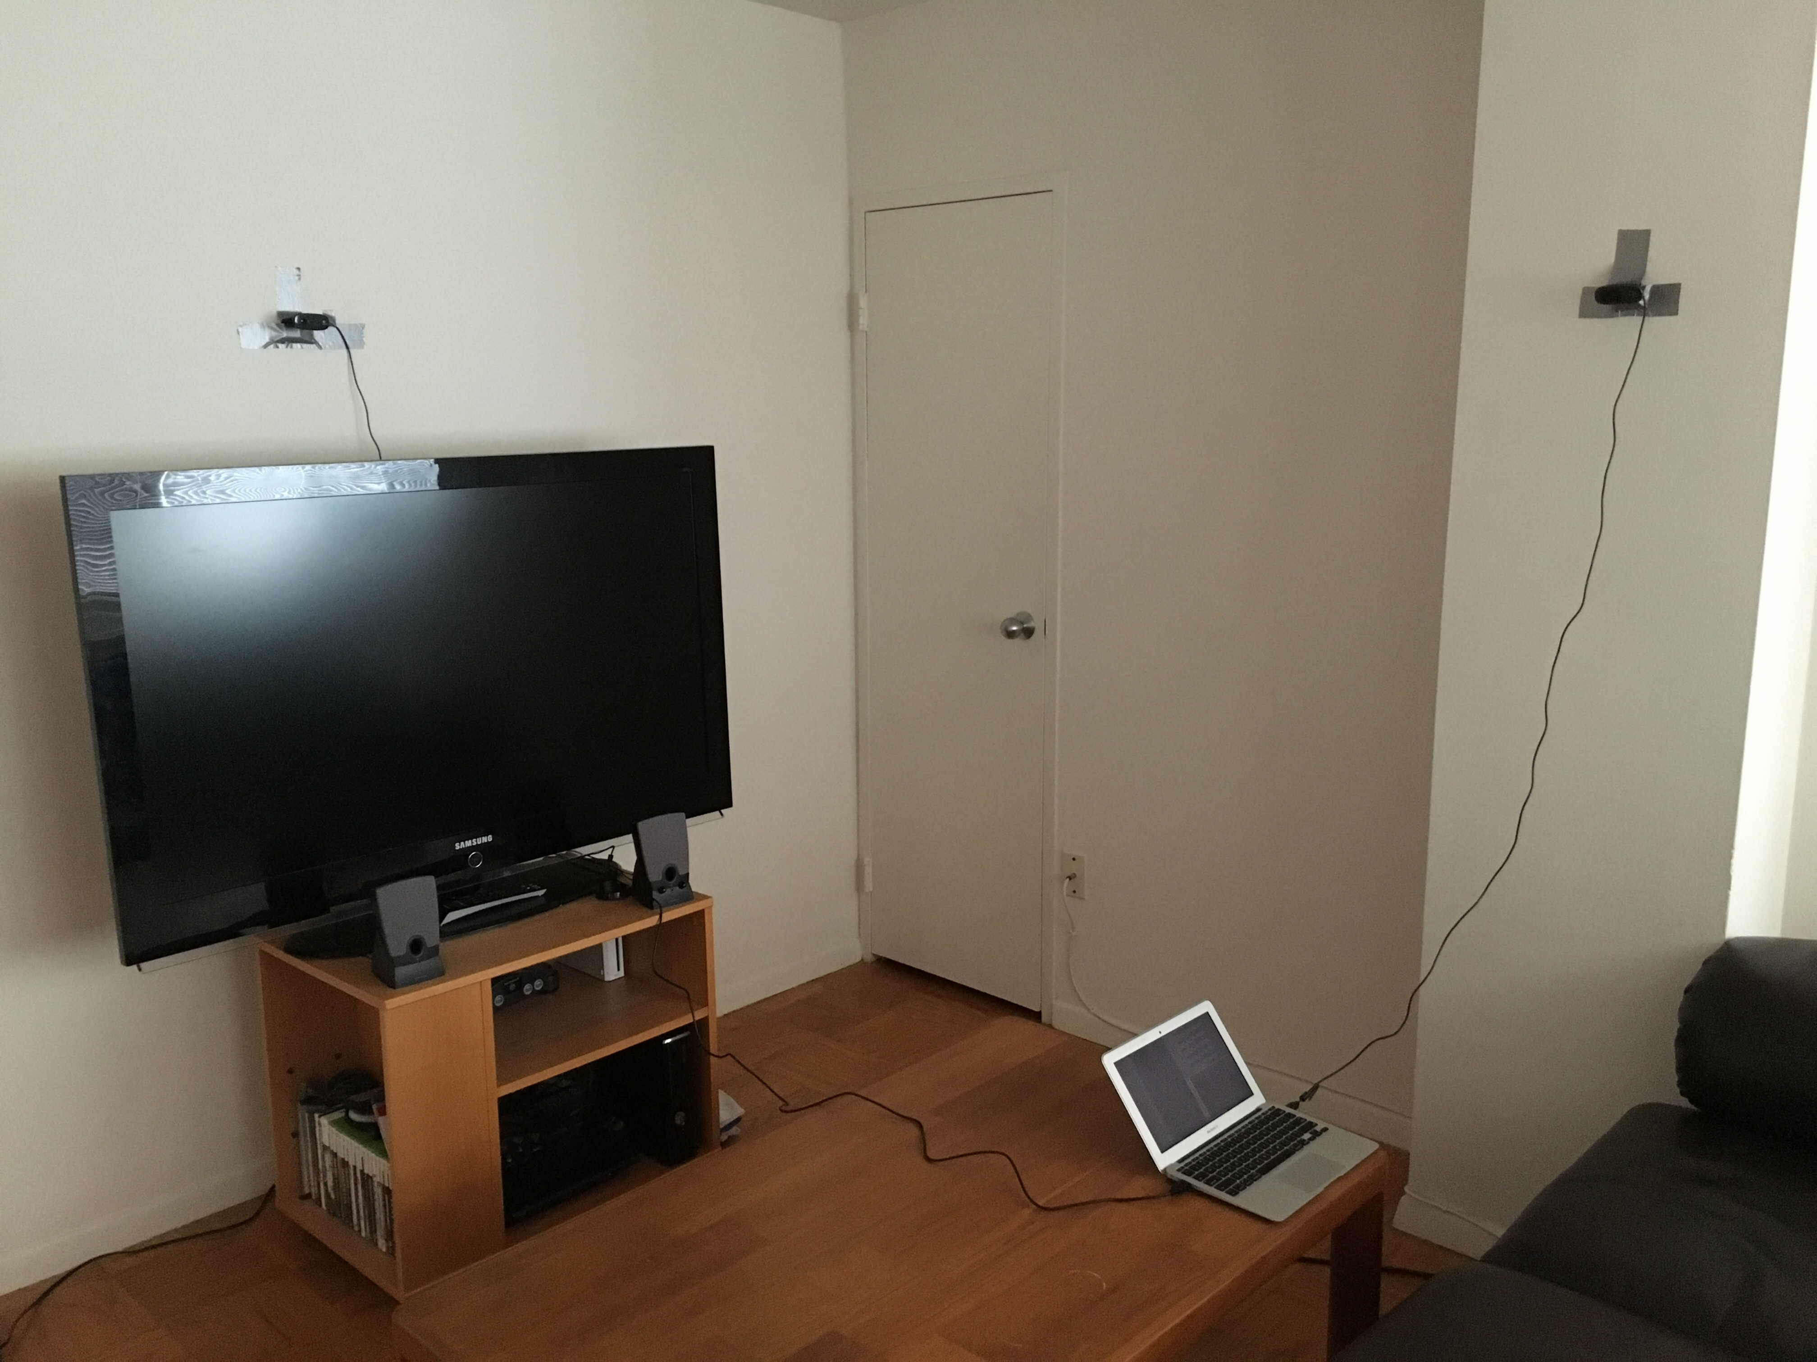
How it Works
Detection
Translation
Notes:
Include picture of my setup here with less info on individual bullets.

Slide 6
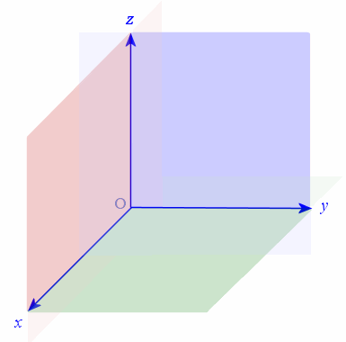
Get 2D Coordinate
Color detection
Translate to vector
Using camera intrinsics
Move to world coordinates
Using camera locations
C
C

Slide 7
The Setup
1.48, 1.80, 2.05

Slide 8
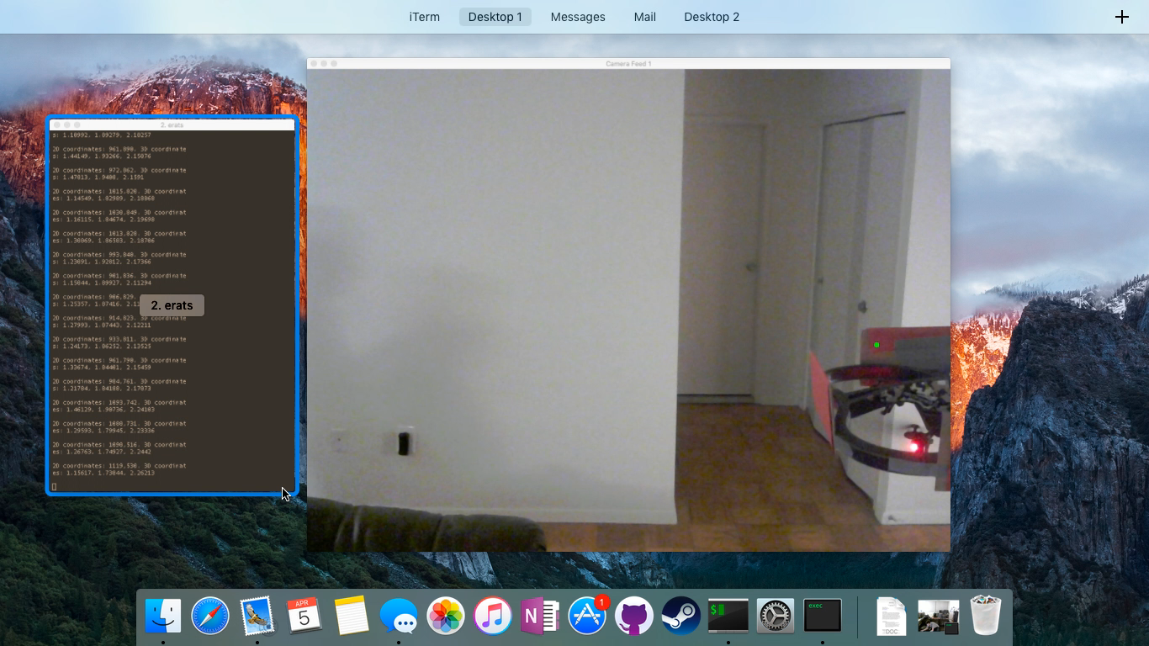
Runtime
Setup: 1.48, 1.80, 2.05
Match!
1.38, 1.65, 2.61

Slide 9
A Complete System
Compare Actual vs Expected
Backup System
DRATS
Notes:
So how does DRATS fit into a greater system and how does it ensure drones’ security?

Slide 10
Other Applications
Thank you
Medical Services
Fire Suppression
Police Support
Photography
Notes:
Start with photo of Amazon drone. But it's not just Amazon. Fade into other corners of medical, fire, and other uses. Then fade into a thank you at the middle.

